Slide 1
Python Programming
Unit 3 & 4:
Modules and Packages ,
File Handling, Exceptions
& Regular Expressions

Slide 2
Introduction to Modules and Packages in Python
Python, a versatile and powerful programming language, supports modular programming through the use of modules and packages.
A module in Python is a single file containing Python code, such as functions, classes, and variables.
Think of modules as self-contained units of code that enhance maintainability and reusability.
A package is a collection of related modules organized in a directory.
Packages offer a structured approach to organizing code, enhancing project management and collaboration.
Benefits include code organization, reusability, and collaborative development.

Slide 3
Creating Modules in Python
Modules in Python are self-contained units of code.
To create a module, open your IDE or text editor and create a new file with a .py extension.
Define functions, classes, and variables in this file to encapsulate related code.
Modules can be run independently using the terminal: python module_name.py.
This allows testing and execution of code within the module.

Slide 4
Creating Packages in Python
Packages in Python are collections of related modules organized in a directory.
To create a package:
Organize related modules into a directory.
Include an __init__.py file to signal that it's a package.
Packages provide a structured way to manage and organize code.

Slide 5
The from…import Statement
A module may contain definition for many variables and functions. When you import a module, you can use any variable or function defined in that module. But if you want to use only selected variables or functions, then you can use the from...import statement. For example, in the aforementioned program you are using only the path variable in the sys module, so you could have better written from sys import path.
Example:
To import more than one item from a module, use a comma separated list. For example, to import the value of pi and sqrt() from the math module you can write,

Slide 6
Making your own Modules
Every Python program is a module, that is, every file that you save as .py extension is a module.
Examples:

Slide 7
The dir() function
dir() is a built-in function that lists the identifiers defined in a module. These identifiers may include functions, classes and variables. If no name is specified, the dir() will return the list of names defined in the current module.
Example:

Slide 8
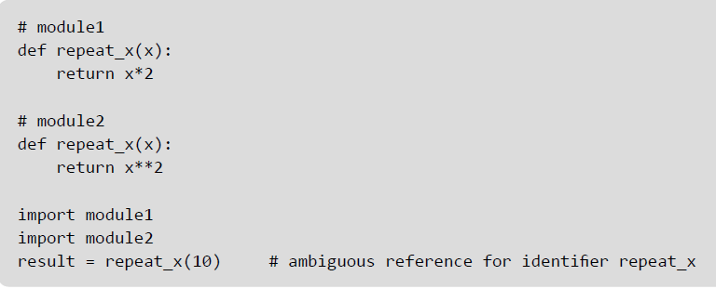
Modules and Namespaces
A namespace is a container that provides a named context for identifiers. Two identifiers with the same name in the same scope will lead to a name clash. In simple terms, Python does not allow programmers to have two different identifiers with the same name. However, in some situations we need to have same name identifiers. To cater to such situations, namespaces is the keyword. Namespaces enable programs to avoid potential name clashes by associating each identifier with the namespace from which it originates.
Example:

Slide 9
Local, Global, and Built-in Namespaces
During a program’s execution, there are three main namespaces that are referenced- the built-in namespace, the global namespace, and the local namespace. The built-in namespace, as the name suggests contains names of all the built-in functions, constants, etc that are already defined in Python. The global namespace contains identifiers of the currently executing module and the local namespace has identifiers defined in the currently executing function (if any).
When the Python interpreter sees an identifier, it first searches the local namespace, then the global namespace, and finally the built-in namespace. Therefore, if two identifiers with same name are defined in more than one of these namespaces, it becomes masked.

Slide 10
Local, Global, and Built-in Namespaces
Example:

Slide 11
Module Private Variables
In Python, all identifiers defined in a module are public by default. This means that all identifiers are accessible by any other module that imports it. But, if you want some variables or functions in a module to be privately used within the module, but not to be accessed from outside it, then you need to declare those identifiers as private.
In Python identifiers whose name starts with two underscores (__) are known as private identifiers. These identifiers can be used only within the module. In no way, they can be accessed from outside the module. Therefore, when the module is imported using the import * form modulename, all the identifiers of a module’s namespace is imported except the private ones (ones beginning with double underscores). Thus, private identifiers become inaccessible from within the importing module.

Slide 12
Packages in Python
A package is a hierarchical file directory structure that has modules and other packages within it. Like modules, you can very easily create packages in Python.
Every package in Python is a directory which must have a special file called __init__.py. This file may not even have a single line of code. It is simply added to indicate that this directory is not an ordinary directory and contains a Python package. In your programs, you can import a package in the same way as you import any module.
For example, to create a package called MyPackage, create a directory called MyPackage having the module MyModule and the __init__.py file. Now, to use MyModule in a program, you must first import it. This can be done in two ways.
import MyPackage.MyModule
or
from MyPackage import MyModule

Slide 13
Globals(), Locals(), And Reload()
The globals() and locals() functions are used to return the names in the global and local namespaces (In Python, each function, module, class, package, etc owns a “namespace” in which variable names are identified and resolved). The result of these functions is of course, dependent on the location from where they are called. For example,
If locals() is called from within a function, names that can be accessed locally from that function will be returned.
If globals() is called from within a function, all the names that can be accessed globally from that function is returned.
Reload()- When a module is imported into a program, the code in the module is executed only once. If you want to re-execute the top-level code in a module, you must use the reload() function. This function again imports a module that was previously imported.

Slide 14
Standard Modules: sys
Command-Line Arguments:
sys.argv: A list containing command-line arguments passed to the script.
System Exit:
sys.exit(): Function to exit the Python interpreter.
Standard I/O Streams:
sys.stdin, sys.stdout, sys.stderr: Standard input, output, and error streams.
System-Specific Information:
sys.platform: String identifying the platform.
sys.version: String containing the Python version.
Module Import Path:
sys.path: List of strings specifying the search path for modules.

Slide 15
Standard Modules: math
Basic Mathematical Functions:
math.sqrt(x): Returns the square root of x.
math.pow(x, y): Returns x raised to the power y.
math.exp(x): Returns the exponential of x (e^x).
math.log(x[, base]): Returns the natural logarithm of x (base e), or the logarithm of x to the specified base.
2. Trigonometric Functions:
math.sin(x), math.cos(x), math.tan(x): Returns the sine, cosine, and tangent of x, where x is in radians.
math.radians(x): Converts angle x from degrees to radians.
math.degrees(x): Converts angle x from radians to degrees.
3. Hyperbolic Functions:
math.sinh(x), math.cosh(x), math.tanh(x): Returns the hyperbolic sine, cosine, and tangent of x.
4. Angular Conversion:
math.asin(x), math.acos(x), math.atan(x): Returns the arcsine, arccosine, and arctangent of x, where the result is in radians.
math.atan2(y, x): Returns the arctangent of y/x, in radians.
5. Constants:
math.pi: A constant representing the mathematical constant π (pi).
math.e: A constant representing the mathematical constant e.
6. Other Functions:
math.floor(x), math.ceil(x): Return the floor and ceiling of x as a float, respectively.
math.factorial(x): Returns the factorial of x.
7. Statistical Functions:
math.mean(iterable): Returns the mean (average) of a sequence of numbers.
math.median(iterable): Returns the median of a sequence of numbers.
math.stdev(iterable): Returns the standard deviation of a sequence of numbers.

Slide 16
Standard Modules: time
Function | Description
time.time() | Returns the current time in seconds since the epoch (January 1, 1970).
time.sleep(secs) | Suspends the execution of the current thread for the given number of seconds.
time.ctime([secs]) | Converts a time in seconds since the epoch to a string representing a local time.
time.localtime([secs]) | Converts a time in seconds since the epoch to a struct_time in local time.
time.strftime(format, [t]) | Converts a struct_time object or a time in seconds to a string based on the format string passed.
time.gmtime([secs]) | Similar to localtime(), but returns the Coordinated Universal Time (UTC).

Slide 17
Standard Modules: os
The os module in Python provides a way to interact with the operating system, allowing you to perform various system-related tasks
os.environ.get('variable_name') | Returns the value of the specified environment variable.
os.system(command) | Executes the command (string) in a subshell.
os.popen(command) | Opens a pipe to or from the command.
os.stat(path) | Returns information about a file.
os.remove(path) | Removes a file.
os.rmdir(path) | Removes an empty directory.
os.name | Returns the name of the operating system dependent module imported.
os.system('clear' if os.name == 'posix' else 'cls') | Clears the console screen based on the operating system.
os.getpid() | Returns the current process ID.
os.kill(pid, signal) | Sends a signal to a process identified by its process ID.
os.chmod(path, mode) | Changes the permissions of a file.
os.chown(path, uid, gid) | Changes the owner and group id of a file.
Function/Attribute | Description
os.getcwd() | Returns the current working directory.
os.chdir(path) | Changes the current working directory to the specified path.
os.listdir(path='.') | Returns a list of filenames in the specified directory (default is the current directory).
os.mkdir(path) | Creates a new directory at the specified path.
os.makedirs(path) | Creates a directory and any necessary parent directories.
os.path.join(path, *paths) | Join one or more path components intelligently.
os.path.exists(path) | Returns True if the specified path exists.
os.path.isfile(path) | Returns True if the path is a regular file.
os.path.isdir(path) | Returns True if the path is a directory.
os.path.abspath(path) | Returns the absolute version of a path.
os.environ | A dictionary containing the environment variables.

Slide 18
Standard Modules: timeit
The timeit module in Python is a convenient tool for measuring the execution time of small bits of Python code.
It provides a simple way to assess the performance of code snippets
import timeit
def func1(n):
return [i for i in range(n)]
def func2(n):
return list(range(n))
# Time the execution of each function
time1 = timeit.timeit(lambda: func1(1000000), number=1000)
time2 = timeit.timeit(lambda: func2(1000000), number=1000)
# Print the results
print(f"Time taken by func1: {time1:.4f} seconds")
print(f"Time taken by func2: {time2:.4f} seconds")
timeit.timeit() Function:
The timeit.timeit(stmt, setup, timer, number) function takes a statement stmt, a setup code setup, a timer function timer, and the number of executions number.
It returns the time taken to execute the statement a given number of times.
O/P:
Time taken by func1: 54.4587 seconds
Time taken by func2: 21.4928 seconds

Slide 19
File
A file is a collection of data stored on a secondary storage device like hard disk.
A file is basically used because real-life applications involve large amounts of data and in such situations the console oriented I/O operations pose two major problems:
• First, it becomes cumbersome and time consuming to handle huge amount of data through terminals.
• Second, when doing I/O using terminal, the entire data is lost when either the program is terminated or computer is turned off. Therefore, it becomes necessary to store data on a permanent storage (the disks) and read whenever necessary, without destroying the data.

Slide 20
File Path
Files that we use are stored on a storage medium like the hard disk in such a way that they can be easily retrieved as and when required.
Every file is identified by its path that begins from the root node or the root folder. In Windows, C:\ (also known as C drive) is the root folder but you can also have a path that starts from other drives like D:\, E:\, etc. The file path is also known as pathname.
Relative Path and Absolute Path
A file path can be either relative or absolute. While an absolute path always contains the root and the complete directory list to specify the exact location the file, relative path needs to be combined with another path in order to access a file. It starts with respect to the current working directory and therefore lacks the leading slashes. For example, C:\Students\Under Graduate\BTech_CS.docx but Under Graduate\BTech_CS.docx is a relative path as only a part of the complete path is specified.

Slide 21
ASCII Text Files
A text file is a stream of characters that can be sequentially processed by a computer in forward direction. For this reason a text file is usually opened for only one kind of operation (reading, writing, or appending) at any given time. Because text files can process characters, they can only read or write data one character at a time. In Python, a text stream is treated as a special kind of file.
Depending on the requirements of the operating system and on the operation that has to be performed (read/write operation) on the file, the newline characters may be converted to or from carriage-return/linefeed combinations. Besides this, other character conversions may also be done to satisfy the storage requirements of the operating system. However, these conversions occur transparently to process a text file. In a text file, each line contains zero or more characters and ends with one or more characters
Another important thing is that when a text file is used, there are actually two representations of data- internal or external. For example, an integer value will be represented as a number that occupies 2 or 4 bytes of memory internally but externally the integer value will be represented as a string of characters representing its decimal or hexadecimal value.

Slide 22
Binary Files
A binary file is a file which may contain any type of data, encoded in binary form for computer storage and processing purposes. It includes files such as word processing documents, PDFs, images, spreadsheets, videos, zip files and other executable programs. Like a text file, a binary file is a collection of bytes. A binary file is also referred to as a character stream with following two essential differences.
• A binary file does not require any special processing of the data and each byte of data is transferred to or from the disk unprocessed.
• Python places no constructs on the file, and it may be read from, or written to, in any manner the programmer wants.
While text files can be processed sequentially, binary files, on the other hand, can be either processed sequentially or randomly depending on the needs of the application.

Slide 23
The Open() Function
Before reading from or writing to a file, you must first open it using Python’s built-in open() function. This function creates a file object, which will be used to invoke methods associated with it. The syntax of open() is:
fileObj = open(file_name [, access_mode])
Here,
file_name is a string value that specifies name of the file that you want to access.
access_mode indicates the mode in which the file has to be opened, i.e., read, write, append, etc.
Example:

Slide 24
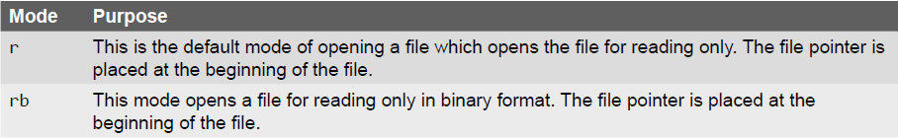
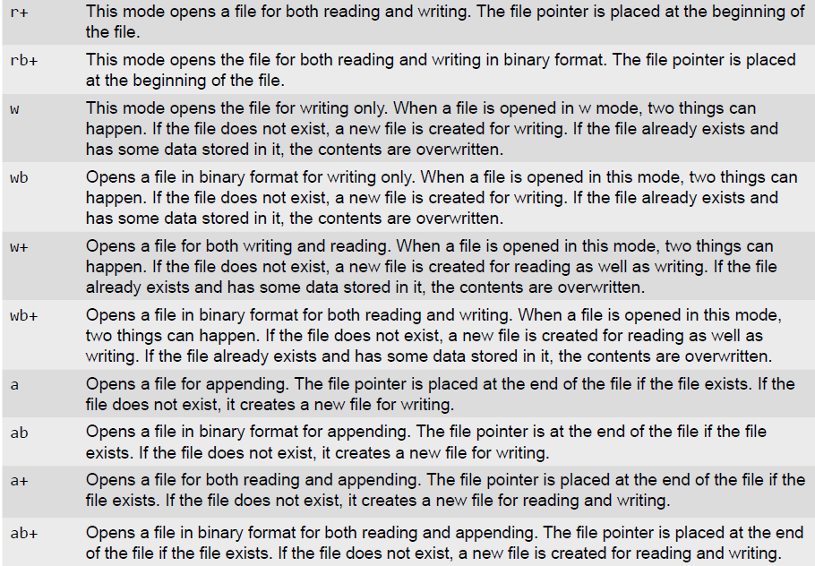
The open() Function – Access Modes

Slide 25
The File Object Attributes
Once a file is successfully opened, a file object is returned. Using this file object, you can easily access different type of information related to that file. This information can be obtained by reading values of specific attributes of the file.
Example:

Slide 26
The close () Method
The close() method is used to close the file object. Once a file object is closed, you cannot further read from or write into the file associated with the file object. While closing the file object the close() flushes any unwritten information. Although, Python automatically closes a file when the reference object of a file is reassigned to another file, but as a good programming habit you should always explicitly use the close() method to close a file. The syntax of close() is fileObj.close()
The close() method frees up any system resources such as file descriptors, file locks, etc. that are associated with the file. Moreover, there is an upper limit to the number of files a program can open. If that limit is exceeded then the program may even crash or work in unexpected manner. Thus, you can waste lots of memory if you keep many files open unnecessarily and also remember that open files always stand a chance of corruption and data loss.
Once the file is closed using the close() method, any attempt to use the file object will result in an error.

Slide 27
The write() and writelines() Methods
The write() method is used to write a string to an already opened file. Of course this string may include numbers, special characters or other symbols. While writing data to a file, you must remember that the write() method does not add a newline character ('\n') to the end of the string. The syntax of write() method is: fileObj.write(string)
The writelines() method is used to write a list of strings.
Examples:

Slide 28
append() Method
Once you have stored some data in a file, you can always open that file again to write more data or append data to it. To append a file, you must open it using 'a' or 'ab' mode depending on whether it is a text file or a binary file. Note that if you open a file in 'w' or 'wb' mode and then start writing data into it, then its existing contents would be overwritten. So always open the file in 'a' or 'ab' mode to add more data to existing data stored in the file.
Appending data is especially essential when creating a log of events or combining a large set of data into one file.
Example:

Slide 29
The read() and readline() Methods
The read() method is used to read a string from an already opened file. As said before, the string can include, alphabets, numbers, characters or other symbols. The syntax of read() method is fileObj.read([count])
In the above syntax, count is an optional parameter which if passed to the read() method specifies the number of bytes to be read from the opened file. The read() method starts reading from the beginning of the file and if count is missing or has a negative value then, it reads the entire contents of the file (i.e., till the end of file).
The readlines() method is used to read all the lines in the file
Example:

Slide 30
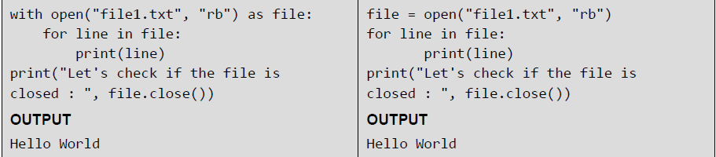
Opening Files using “with” Keyword
It is good programming habit to use the with keyword when working with file objects. This has the advantage that the file is properly closed after it is used even if an error occurs during read or write operation or even when you forget to explicitly close the file.
Examples:

Slide 31
Splitting Words
Python allows you to read line(s) from a file and splits the line (treated as a string) based on a character. By default, this character is space but you can even specify any other character to split words in the string.
Example:

Slide 32
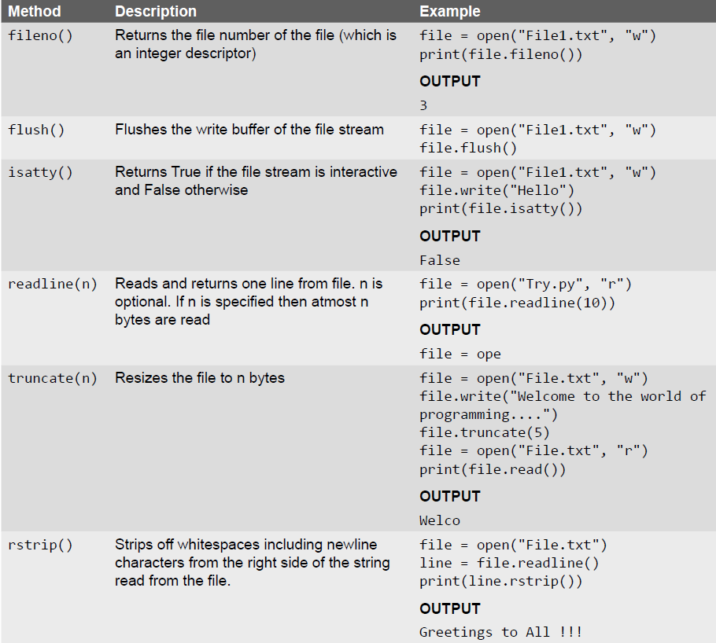
Some Other Useful File Methods

Slide 33
File Positions
With every file, the file management system associates a pointer often known as file pointer that facilitate the movement across the file for reading and/ or writing data. The file pointer specifies a location from where the current read or write operation is initiated. Once the read/write operation is completed, the pointer is automatically updated.
Python has various methods that tells or sets the position of the file pointer. For example, the tell() method tells the current position within the file at which the next read or write operation will occur. It is specified as number of bytes from the beginning of the file. When you just open a file for reading, the file pointer is positioned at location 0, which is the beginning of the file.
The seek(offset[, from]) method is used to set the position of the file pointer or in simpler terms, move the file pointer to a new location. The offset argument indicates the number of bytes to be moved and the from argument specifies the reference position from where the bytes are to be moved.

Slide 34
File Positions - Example

Slide 35
Renaming and Deleting Files
The os module in Python has various methods that can be used to perform file-processing operations like renaming and deleting files. To use the methods defined in the os module, you should first import it in your program then call any related functions.
The rename() Method: The rename() method takes two arguments, the current filename and the new filename. Its syntax is: os.rename(old_file_name, new_file_name)
The remove() Method: This method can be used to delete file(s). The method takes a filename (name of the file to be deleted) as an argument and deletes that file. Its syntax is: os.remove(file_name)
Examples:

Slide 36
Directory Methods
The mkdir() Method: The mkdir()method of the OS module is used to create directories in the current directory. The method takes the name of the directory (the one to be created) as an argument. The syntax of mkdir() is, os.mkdir("new_dir_name")
The getcwd() Method: The getcwd() method is used to display the current working directory (cwd).
os.getcwd()
The chdir() Method: The chdir() method is used to change the current directory. The method takes the name of the directory which you want to make the current directory as an argument. Its syntax is
os.chdir("dir_name")
The rmdir() Method: The rmdir() method is used to remove or delete a directory. For this, it accepts name of the directory to be deleted as an argument. However, before removing a directory, it should be absolutely empty and all the contents in it should be removed. The syntax of remove() method is os.rmdir(("dir_name")
The makedirs() method: The method mkdirs() is used to create more than one folder.

Slide 37
Directory Methods - Examples

Slide 38
Errors and Exceptions
The programs that we write may behave abnormally or unexpectedly because of some errors and/or exceptions. The two common types of errors that we very often encounter are syntax errors and logic errors. While logic errors occur due to poor understanding of problem and its solution, syntax errors, on the other hand, arises due to poor understanding of the language. However, such errors can be detected by exhaustive debugging and testing of procedures.
But many a times, we come across some peculiar problems which are often categorized as exceptions. Exceptions are run-time anomalies or unusual conditions (such as divide by zero, accessing arrays out of its bounds, running out of memory or disk space, overflow, and underflow) that a program may encounter during
execution. Like errors, exceptions can also be categorized as synchronous and asynchronous exceptions. While
synchronous exceptions (like divide by zero, array index out of bound, etc.) can be controlled by the program,
asynchronous exceptions (like an interrupt from the keyboard, hardware malfunction, or disk failure), on the
other hand, are caused by events that are beyond the control of the program.

Slide 39
Syntax and Logic Errors
Syntax errors occurs when we violate the rules of Python and they are the most common kind of error that we get while learning a new language. For example, consider the lines of code given below.
>>> i=0
>>> if i == 0 print(i)
SyntaxError: invalid syntax
Logic error specifies all those type of errors in which the program executes but gives incorrect results. Logical error may occur due to wrong algorithm or logic to solve a particular program. In some cases, logic errors may lead to divide by zero or accessing an item in a list where the index of the item is outside the bounds of the list. In this case, the logic error leads to a run-time error that causes the program to terminate abruptly. These types of run-time errors are known as exceptions.

Slide 40
Exceptions
Even if a statement is syntactically correct, it may still cause an error when executed. Such errors that occur
at run-time (or during execution) are known as exceptions. An exception is an event, which occurs during
the execution of a program and disrupts the normal flow of the program's instructions. When a program
encounters a situation which it cannot deal with, it raises an exception. Therefore, we can say that an exception is a Python object that represents an error.
When a program raises an exception, it must handle the exception or the program will be immediately
terminated. You can handle exceptions in your programs to end it gracefully, otherwise, if exceptions are not
handled by programs, then error messages are generated..

Slide 41
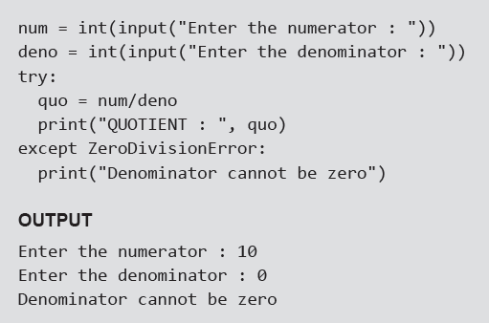
Handling Exceptions
We can handle exceptions in our program by using try block and except block. A critical operation which can raise exception is placed inside the try block and the code that handles exception is written in except block. The syntax for try–except block can be given as,
Example:

Slide 42
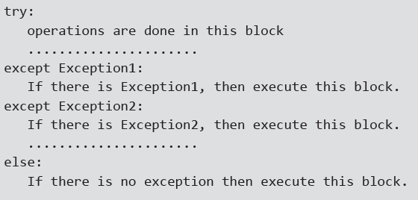
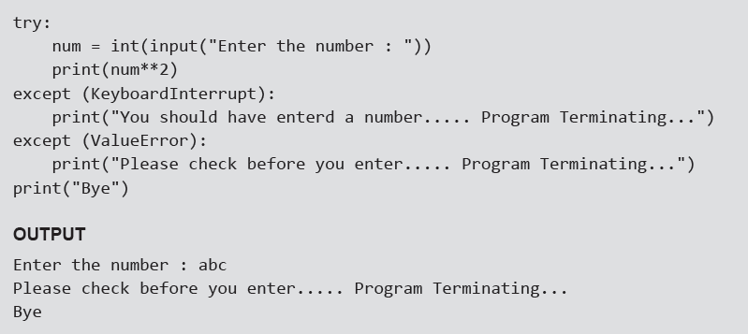
Multiple Except Blocks
Python allows you to have multiple except blocks for a single try block. The block which matches with the exception generated will get executed. A try block can be associated with more than one except block to specify handlers for different exceptions. However, only one handler will be executed. Exception handlers only handle exceptions that occur in the corresponding try block. We can write our programs that handle selected exceptions. The syntax for specifying multiple except blocks for a single try block can be given as,
Example:

Slide 43
Multiple Exceptions in a Single Block — Example

Slide 44
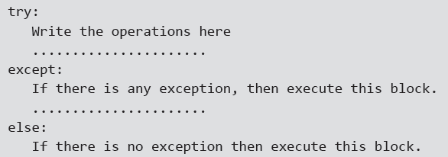
except: Block without Exception
You can even specify an except block without mentioning any exception (i.e., except:). This type of except
block if present should be the last one that can serve as a wildcard (when multiple except blocks are present). But use it with extreme caution, since it may mask a real programming error.
In large software programs, may a times, it is difficult to anticipate all types of possible exceptional
conditions. Therefore, the programmer may not be able to write a different handler (except block) for every
individual type of exception. In such situations, a better idea is to write a handler that would catch all types of exceptions. The syntax to define a handler that would catch every possible exception from the try block is,

Slide 45
Except Block Without Exception — Example

Slide 46
The Else Clause
The try ... except block can optionally have an else clause, which, when present, must follow all except blocks. The statement(s) in the else block is executed only if the try clause does not raise an exception.
Examples:

Slide 47
Raising Exceptions
You can deliberately raise an exception using the raise keyword. The general syntax for the raise statement is, raise [Exception [, args [, traceback]]]
Here, Exception is the name of exception to be raised (example, TypeError). args is optional and specifies a value for the exception argument. If args is not specified, then the exception argument is None. The final
argument, traceback, is also optional and if present, is the traceback object used for the exception.
Example:

Slide 48
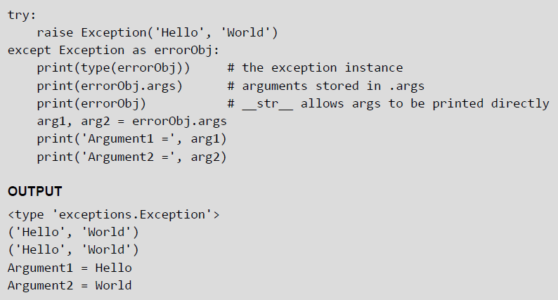
Instantiating Exceptions
Python allows programmers to instantiate an exception first before raising it and add any attributes (or arguments) to it as desired. These attributes can be used to give additional information about the error. To instantiate the exception, the except block may specify a variable after the exception name. The variable then becomes an exception instance with the arguments stored in instance.args. The exception instance also has the __str__() method defined so that the arguments can be printed directly without using instance.args.
Example:

Slide 49
Handling Exceptions In Invoked Functions
Example:

Slide 50
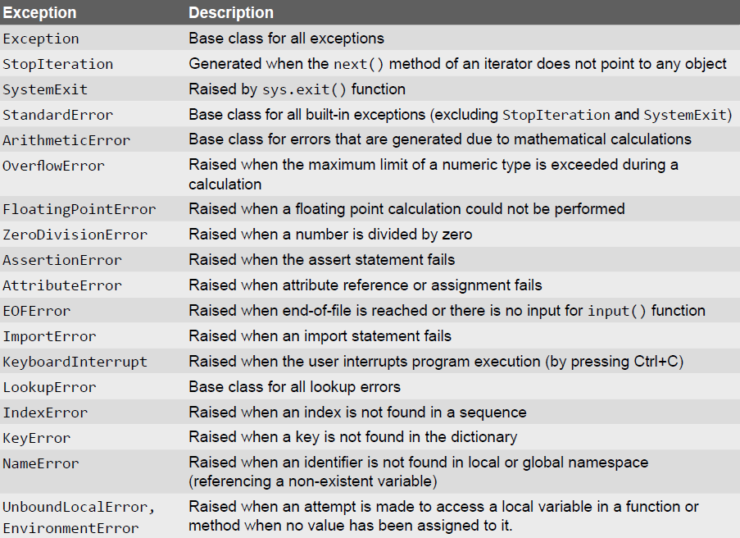
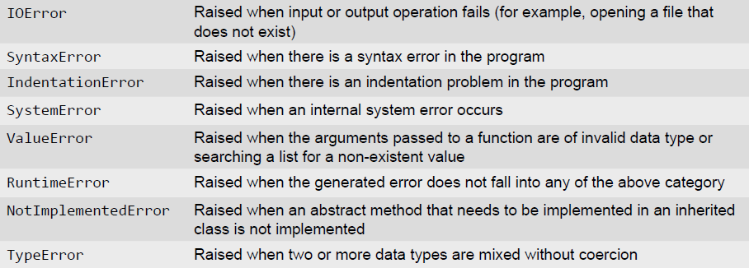
Built-in and User-defined Exceptions

Slide 51
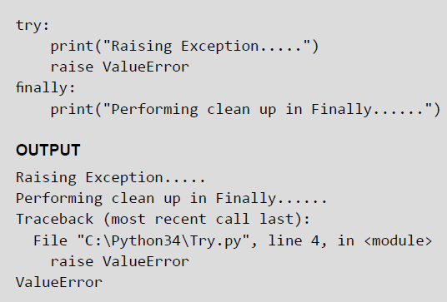
The finally Block
The try block has another optional block called finally which is used to define clean-up actions that must be
executed under all circumstances. The finally block is always executed before leaving the try block. This means that the statements written in finally block are executed irrespective of whether an exception has occurred or not. The syntax of finally block can be given as,
try:
Write your operations here
......................
Due to any exception, operations written here will be skipped
finally:
This would always be executed.
......................
Example:

Slide 52
Pre-defined Clean–up Action
In Python, some objects define standard clean-up actions that are automatically performed when the object
is no longer needed. The default clean-up action is performed irrespective of whether the operation using the object succeeded or failed. We have already seen such an operation in file handling. We preferred to open
the file using with keyword so that the file is automatically closed when not in use. So, even if we forget to close the file or the code to close it is skipped because of an exception, the file will still be closed.
Example:

Slide 53
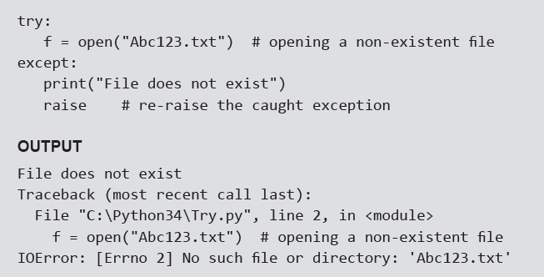
Re-raising Exception
Python allows programmers to re-raise an exception. For example, an exception thrown from the try block
can be handled as well as re-raised in the except block using the keyword raise. The code given below
illustrates this concept.
Example: Program to re-raise the exception

Slide 54
Assertions in Python
An assertion is a basic check that can be turned on or off when the program is being tested. You can think of assert as a raise-if statement (or a raise-if-not statement). Using the assert statement, an expression is tested, and if the result of the expression is False then an exception is raised. The assert statement is intended for debugging statements. It can be seen as an abbreviated notation for a conditional raise statement.
In Python, assertions are implemented using assert keyword. Assertions are usually placed at the start of a function to check for valid input, and after a function call to check for valid output.
When Python encounters an assert statement, the expression associated with it is calculated and if the
expression is False, an AssertionError is raised. The syntax for assert statement is,
assert expression[, arguments]
If the expression is False (also known as assertion fails), Python uses ArgumentExpression as the argument for the AssertionError. AssertionError exceptions can be caught and handled like any other exception using the try-except block. However, if the AssertionError is not handled by the program, the program will be terminated and an error message will be displayed. In simple words, the assert statement, is semantically equivalent to writing,
assert <expression>, <message>

Slide 55
Assertions In Python — Example

Slide 56
Regular Expressions
Regular Expressions are a powerful tool for various kinds of string manipulation. These are basically a special text string that is used for describing a search pattern to extract information from text such as code, files, log, spreadsheets, or even documents.
Regular expressions are a domain specific language (DSL) that is present as a library in most of the modern programming languages, besides Python. A regular expression is a special sequence of characters that helps to match or find strings in another string. In Python, regular expressions can be accessed using the re module which comes as a part of the Standard Library
The Match Function
As the name suggest, the match() function matches a pattern to string with optional flags. The syntax of match() function is,
re.match (pattern, string, flags=0)

Slide 57
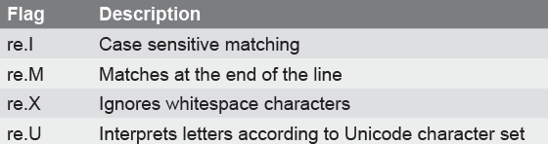
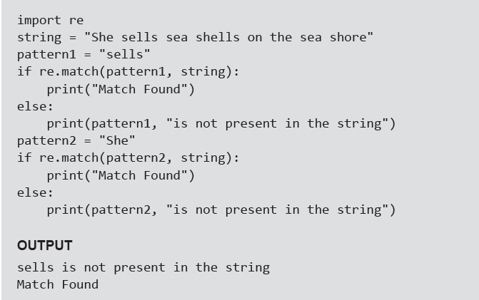
EXAMPLE- Match() Function
Examples:

Slide 58
The search Function
The search() function in the re module searches for a pattern anywhere in the string. Its syntax of can be given as, re.search(pattern, string, flags=0)
The syntax is similar to the match() function. The function searches for first occurrence of pattern within a string with optional flags. If the search is successful, a match object is returned and None otherwise.
Example:

Slide 59
The sub() Function
The sub() function in the re module can be used to search a pattern in the string and replace it with another pattern. The syntax of sub() function can be given as, re.sub(pattern, repl, string, max=0)
According to the syntax, the sub() function replaces all occurrences of the pattern in string with repl, substituting all occurrences unless any max value is provided. This method returns modified string.
Example:

Slide 60
The findall() and finditer() Function
The findall() function is used to search a string and returns a list of matches of the pattern in the string. If no match is found, then the returned list is empty. The syntax of match() function can be given as,
matchList = re.findall(pattern, input_str, flags=0)
Examples:

Slide 61
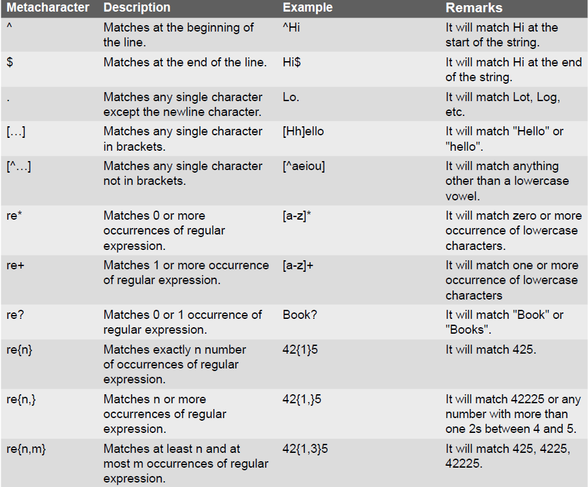
Metacharacters in Regular Expression

Slide 62
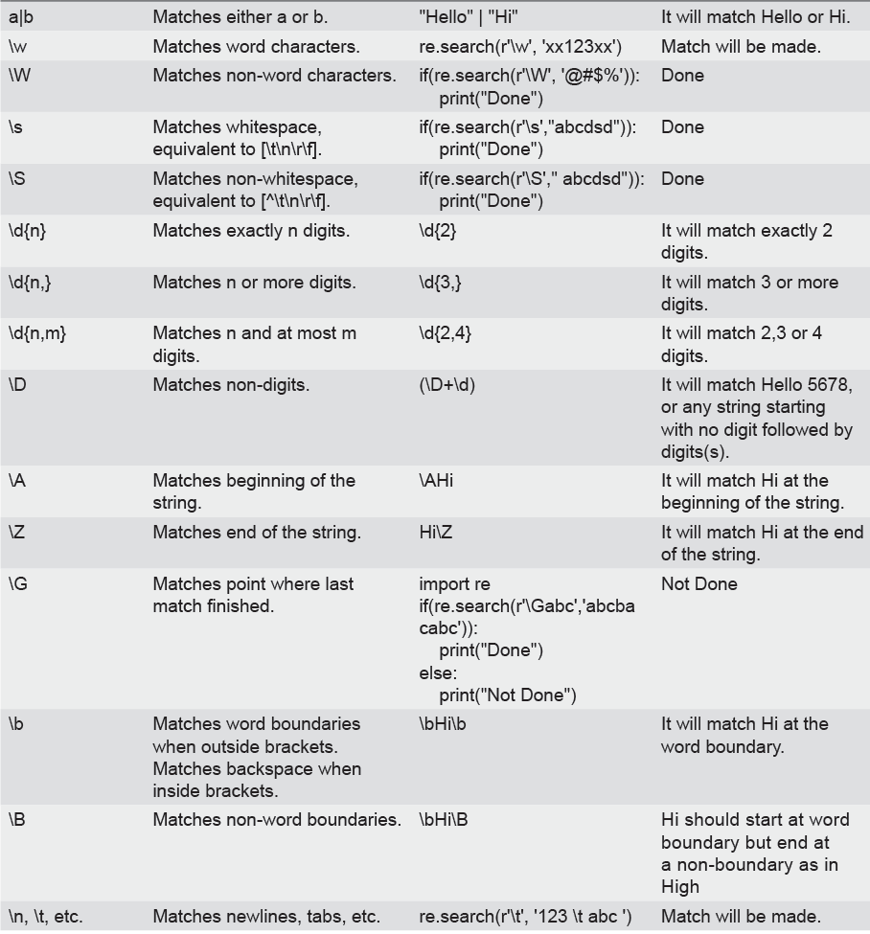
Metacharacters in Regular Expression

Slide 63
Character Classes
When we put the characters to be matched inside square brackets, we call it a character class. For example, [aeiou] defines a character class that has a vowel character.
Examples:

Slide 64
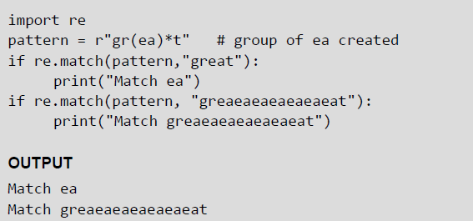
Groups
A group is created by surrounding a part of the regular expression with parentheses. You can even give group as an argument to the metacharacters such as * and ?.
Example:
The content of groups in a match can be accessed by using the group() function. For example,
group(0) or group() returns the whole match.
group(n), where n is greater than 0, returns the nth group from the left.
group() returns all groups up from 1.

